Slide 1
Magic Sand
Nova Maker Faire
George Mason University March 19th 2018
Nick Carter
nickstech@outlook.com

Slide 2


Nova Labs
www.nova-labs.org
Slides link
https://drive.google.com/open?id=1dQKuk6bJjF9JIbjcHju9P31oE-xjRBxMD4njPrmVdKo

Slide 3

Augmented Reality (AR) Sandbox
Design
Oliver Kreylos
Open source design https://arsandbox.ucdavis.edu/
The Augmented Reality Sandbox was developed by the UC Davis W.M. Keck Center for Active Visualization in the Earth Sciences (KeckCAVES, http://www.keckcaves.org), supported by the National Science Foundation under Grant No. DRL 1114663.
Features
High level graphics animations
Rain – holding hand over sand causes rain
Water Flow – rain and water will flow downhill. Water has surface waves
Implementation
Kinext 360 v1 and HDMI projector
PC with LINUX Mint and high end graphics card (Nvidia Geforce 580)
Many various configurations of hardware see Internet
Manual Calibration

Slide 4
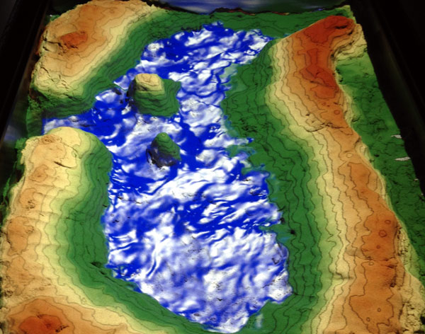
Flowing Water

Slide 5

Magic Sand
Designer
Thomas Wolfe with modifications and games by Rasmus Paulsen
Based on the AR Sandbox design.
Features
No water animation or rain but simple animated games
Shape an island (Not shown here )
Sandimals - Gather fish and bunnies
Mother - Help fish and bunnies reach their mother.
Implementation
Kinext 360 v1 and HDMI projector
Designed to run on average home PC with no special graphics under Windows.7 (will run on Windows 10)
Design, Visual Studio 2013, openframeworks 0.9.3
Runtime, uses Visual C++ the 2013 release for x86 and x64 bit.
Open source design at https://github.com/thomwolf/Magic-Sand/releases/tag/v1.5.4.1

Slide 6
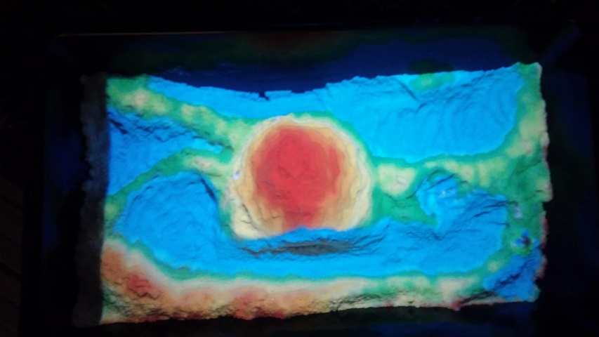
Oceans and Mountains and games

Slide 7
Nova Labs Design
Our Implementation
Dell Inspiron Pentium -2 core 1.7 GHz 64 bit, 8GB RAM, 500 GB HD, 2 , USB2.0 ports (required by Kinect) , HDMI out.
Kinect 360 V1 Model 1414 (used – not available from or supported by MS now)
Projector iDGLAX iDG-787W LCD LED Video Multimedia Mini Portable Projector with Free HDMI cable (This is only 50 lumens so needs a fairly dark room)
Iron frame with casters, camera/projector support frame Projector and Kinect on board velcroed to frame

Slide 8
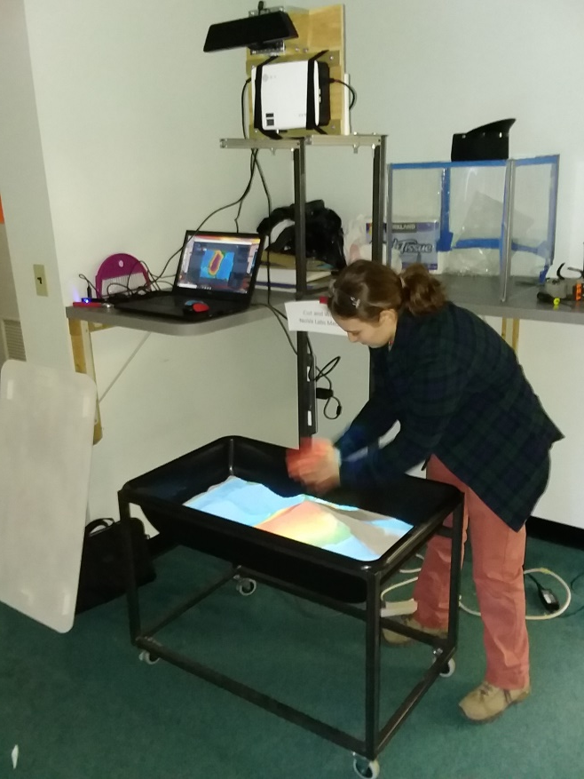
Our Hardware
Sandbox, Frame and Kinect/Projector mounting.
There are many other versions on the Internet
Some have instructions and videos.

Slide 9
How it Works
Measure
AC Power
Display
KINECT
Kinect camera images are also used for calibration on the PC
Camera
USB 2.0 Hub
Projector
Calculate
IR Distance sensor
Map height assigned color to sand location
Initial Calibration
Measure base sand height
And top of box height over sand locations
Update game animal locations according to game rules and animal behavior
Assign a color to sand height ranges
Create image of sand colors and animals for projection
Measure height of sand at locations during game
SANDBOX
Laptop PC

Slide 10

Magic Sandbox
ironwork designed
and fabricated by
Elena Bachman and Sam Steele

